Slide 1


Vivekanand Education Society’s Institute Of Technology
Department Of Information Technology
DSA mini Project
A.Y. 2024-25
Title:
Promoting mental Health
Domain:Mental Health Support
Group Members:
Member1 :Khushi Shukla
Member2:Khushi Singh
Mentor Name:Kajal Jewani
Sustainability Goal

Slide 2
Content
Introduction to the Project
Problem Statement
Objectives of the Project
Scope of the Project
Requirements of the System (Hardware, Software)
ER Diagram of the Proposed System
Data Structure & Concepts Used
Algorithm Explanation
Time and Space Complexity
Front End
Implementation
Gantt Chart
13. Test Cases
14.Challenges and Solutions
15. Future Scope
16. Code
17. Output Screenshots
18. Conclusion
19. References (in IEEE Format)

Slide 3
Introduction to Project
This project aims to create MindMate, a mental health chatbot that leverages data structures like queues, stacks, and linked lists to offer accessible support for mental health challenges.
The chatbot will provide a safe space for users to explore their feelings, offering tailored coping strategies and resources.
By utilizing these data structures, MindMate can maintain coherent conversations, track moods, and facilitate goal-setting. Ultimately, this initiative seeks to merge technology with mental wellness, making mental health support more accessible and empowering for all users.
r Rates

Slide 4
Problem Statement
Mental health issues such as anxiety and depression are on the rise, yet many individuals struggle to access timely and effective support due to barriers like cost, stigma, and availability.
There is a pressing need for an accessible, user-friendly platform that offers immediate mental health assistance and resources.
r Rates

Slide 5
Objectives of the project
The objective of this project is to develop MindMate, a mental health chatbot that:
1.Provide Immediate Support: Offer real-time assistance for mental health challenges.
2. Personalize Experience: Deliver tailored coping strategies and resources.
3. Encourage Self-Reflection: Enable mood logging and tracking.
4. Reduce Barriers: Make mental health support more accessible.
5. Promote Well-Being: Empower users to manage their mental health and build resilience.

Slide 6
SS J Scope of the Project
Project Scope for Mental Health Chatbot
Conversation Tracking: Use a stack to maintain chat history.
User Request Management: Implement a queue for handling requests.
User Profiles:Store profiles with a linked list for personalized support.
Empathetic Responses:Provide supportive interactions based on user inputs.
Future Enhancements
- Machine learning integration for better personalization.
- Mobile application development.
- Expanded resources and coping strategies.
Target Audience
Individuals seeking accessible mental health support.
Limitations
- Not a replacement for professional therapy.
- Responses are based on predefined patterns.

Slide 7
Requirements of the system (Hardware, software)
Hardware Requirements
1.Server: Dual-core CPU, 4 GB RAM, 50 GB SSD storage.
2.User Devices: PC/Laptop (Windows, Linux).
Software Requirements
1.Programming Language: C
2.Development Tools:
a. Compiler: GCC
b. IDE: Code::Blocks or Visual Studio Code

Slide 8
Data Structure and Concepts Used
1. Stack- To track conversation history, allowing the chatbot to recall previous messages for context-aware responses. Push user messages onto the stack and pop them when needed.
2. Queue - To manage user requests efficiently, ensuring that interactions are processed in the order they are received. Enqueue incoming requests and dequeue them for handling.
3. Linked List - To store user profiles, enabling dynamic addition and retrieval of user information for personalized support.Each node contains user data and a pointer to the next profile.
4. Dynamic Memory Management - To allocate and deallocate memory for user messages, profiles, and data structures during runtime, ensuring efficient use of resources.
.

Slide 9
Algorithm Explanation
1.User Interaction Algorithm
- Input: User message
- Process: - Display welcome message and prompt for input.
- Read user input; if "exit," terminate interaction.
- Push input onto the conversation history stack.
- Generate and display a response.
- Enqueue request for future processing.
- Output: Chatbot response
2. Stack Operations Algorithm
- Push:Create a node with the user message, link it to the top, and update the stack.
- Pop:Retrieve and remove the top node, updating the stack pointer.

Slide 10
Algorithm Explanation
3. Queue Operations Algorithm
-Enqueue:Create a node with the request; set it as front and rear if empty, or link it to the current rear.
- Dequeue: Retrieve and remove the front node, updating the front pointer.
4. Linked List Operations Algorithm
- Add Profile: Create a node with user data and link it to the head.
- Retrieve Profile: Traverse the list to find a profile by unique identifier.
5. Dynamic Memory Management
- Use `malloc` for memory allocation and free memory when nodes are no longer needed to prevent leaks.

Slide 11
Time and Space Complexity
Time Complexity:
1.Stack Operations:
Push:O(1)
Pop:O(1)
2.Queue Operations
Enqueue:O(1)
Dequeue:O(1)
3.Linked list for profiles:
Append:O(n)
Free:O(n
4.User interaction flow:
Processing each user request (enqueuing,dequeuing and handling) is O(1) for enqueue and dequeue,but O(n) for updating profiles.

Slide 12
Time and Space Complexity
Space Complexity
1.Stack:
O(k)-Space required for the stack,where k is the maximum number of stored interactions (limited by MAX_STACK_SIZE
2.Queue:
O(m)-Space required for the Queue,where m is the maximum number of incoming requests(limited by MAX_QUEUE_SIZE).
3.Linked list for profiles:
O(n)-Space required for storing user profiles,where n is number of users.

Slide 13
Implementation
Stack Operations:(push) Adds recent user requests to manage conversation history.
(pop) Retrieves the most recent request for easy reference.
Queue Operations:(enqueue)Adds incoming user requests, ensuring FIFO processing.
(dequeue): Removes and processes the front request from the queue.
Linked List for Profiles:Dynamically adds user profiles (name and feelings).
Cleans up memory by deallocating profiles when no longer needed.

Slide 14
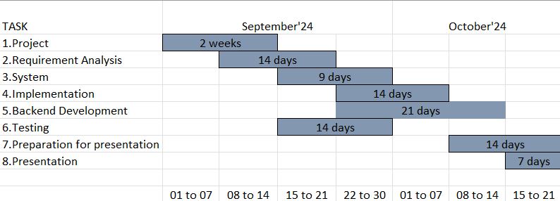
Gantt Chart
Notes:
The max flow algorithm in the visualization is :-

Slide 15
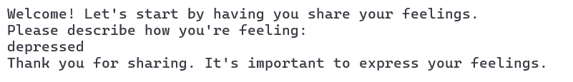
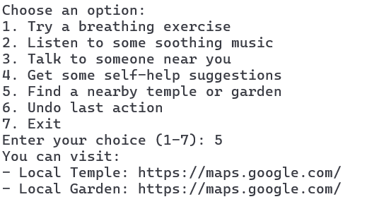
Test Cases
Test Case 1: Basic User Request Handling
Test Case 2:Input handling
Notes:
The max flow algorithm in the visualization is :-

Slide 16
Challenges and Solutions
Challenges and Solutions
1. Managing User Requests -Solution: Implement a queue for orderly processing.
2. User Data Storage - Solution: Use a linked list for dynamic profile management.
3. Memory Management - Solution:Apply dynamic memory allocation techniques.
4. Natural Language Processing - Solution: Utilize string handling for user input.
5. Providing Relevant Support - Solution: Create a database of tailored responses.
Notes:
The max flow algorithm in the visualization is :-

Slide 17
Future Scope
1. Machine Learning Integration - Enhance response personalization based on user behavior and feedback.
2. Mobile Application Development - Create a mobile app for increased accessibility and user engagement.
3. Expanded Resources - Incorporate a broader range of coping strategies and mental health resources.
4. Community Support Features - Introduce options for peer support or group discussions within the platform.
5. Multi-Language Support - Expand language options to reach a wider audience.
6. Data Analytics - Implement analytics to track user interactions and improve chatbot performance.
7. Integration with Professional Services - Facilitate connections to mental health professionals for users needing additional support.
Notes:
The max flow algorithm in the visualization is :-

Slide 18
CODE
int main() {
int choice;
Stack actionStack = { .top = -1 };
Node *feelingsList = NULL;
printf("Welcome! Let's start by having you share your feelings.\n");
// User shares their feelings
shareFeelings(&feelingsList);
while (1) {
printf("\nChoose an option:\n");
printf("1. Try a breathing exercise\n");
printf("2. Listen to some soothing music\n");
printf("3. Talk to someone near you\n");
printf("4. Get some self-help suggestions\n");
printf("5. Find a nearby temple or garden\n");
Notes:
The max flow algorithm in the visualization is :-

Slide 19
CODE
printf("6. Undo last action\n");
printf("7. Exit\n");
printf("Enter your choice (1-7): ");
scanf("%d", &choice);
getchar(); // Clear the newline character
// Push the current choice onto the stack
push(&actionStack, choice);
switch (choice) {
case 1:
breathingExercise();
break;
case 2:
listenToMusic();
break;
case 3:
talkToSomeone();
break;
case 4:
selfHelpSuggestions();
break;
case 5:
findNearbyLocations();
break;
case 6:
if (actionStack.top >= 0) {
printf("Undoing last action: %d\n", pop(&actionStack));
} else {
printf("No actions to undo.\n");
}
break;
Notes:
The max flow algorithm in the visualization is :-

Slide 20
CODE
case 7:
printf("Thank you for chatting! Take care of yourself.\n");
// Free the linked list
while (feelingsList) {
Node *temp = feelingsList;
feelingsList = feelingsList->next;
free(temp);
}
return 0; // Exit the program
default:
printf("Invalid choice. Please try again.\n");
break;
}
}
return 0; // Indicate successful completion of the program
}
Notes:
The max flow algorithm in the visualization is :-

Slide 21
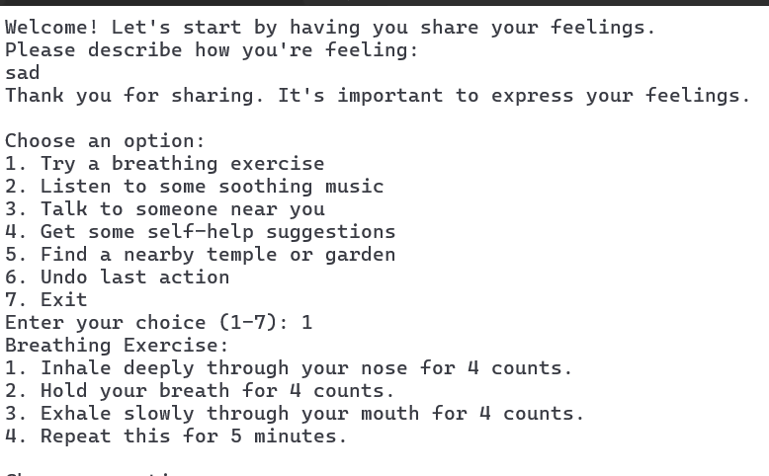
OUTPUT
Notes:
The max flow algorithm in the visualization is :-

Slide 22
Conclusion
MindMate, a mental health chatbot developed in C using stacks, queues, and linked lists, offers an innovative approach to providing accessible mental health support.
By leveraging these data structures, the chatbot effectively manages conversations, tracks user interactions, and allows for mood logging.
This project highlights the potential of technology to enhance mental wellness by making support more interactive and engaging, ultimately empowering users to take control of their mental health.

Slide 23
Literature survey
1.The Saarthi platform employs a structured approach to deliver mental health support through its chatbot, utilizing several key techniques.The chatbot utilizes natural language processing (NLP) and artificial intelligence (AI) to provide Cognitive Behavioral Therapy (CBT) and monitor mental health outcomes.
2. The paper presents Dost, an AI-powered mental health chatbot developed using the Rasa framework and deployed on Telegram. The chatbot aims to address the growing mental health crisis, particularly in countries like India where access to mental health professionals is limited. By leveraging natural language processing (NLP) techniques, the chatbot can understand and respond to user queries related to mental health, offering support and guidance through daily conversations.
3. The paper "Leveraging Chatbots for Mental Health Enhancement" explores the development of an Emotional Assistant Chatbot designed to support mental health by analyzing user-generated voice journals. The system uses Google Text-to-Speech and PyPI Speech Recognition for voice-to-text conversion, followed by the NRC Emotion Lexicon to categorize emotions such as anger, happiness, and sadness.

Slide 24
References
[1] K. Rani, H. Vishnoi and M. Mishra, "A Mental Health Chatbot Delivering Cognitive Behavior Therapy and Remote Health Monitoring Using NLP And AI," 2023 International Conference on Disruptive Technologies (ICDT), Greater Noida, India, 2023, pp. 313-317, doi: 10.1109/ICDT57929.2023.10150665.
[2] A. Diaz and D. Kwak, "Leveraging Chatbots for Mental Health Enhancement," 2023 International Conference on Computational Science and Computational Intelligence (CSCI), Las Vegas, NV, USA, 2023, pp. 137-143, doi: 10.1109/CSCI62032.2023.00028.
[3] A. M. Nayar, Z. Attar, S. Kachwala, T. Biswas and S. K. Wagh, "Dost-Mental Health Assistant Chatbot," 2022 5th International Conference on Advances in Science and Technology (ICAST), Mumbai, India, 2022, pp. 252-257, doi: 10.1109/ICAST55766.2022.10039576

